Slide 1
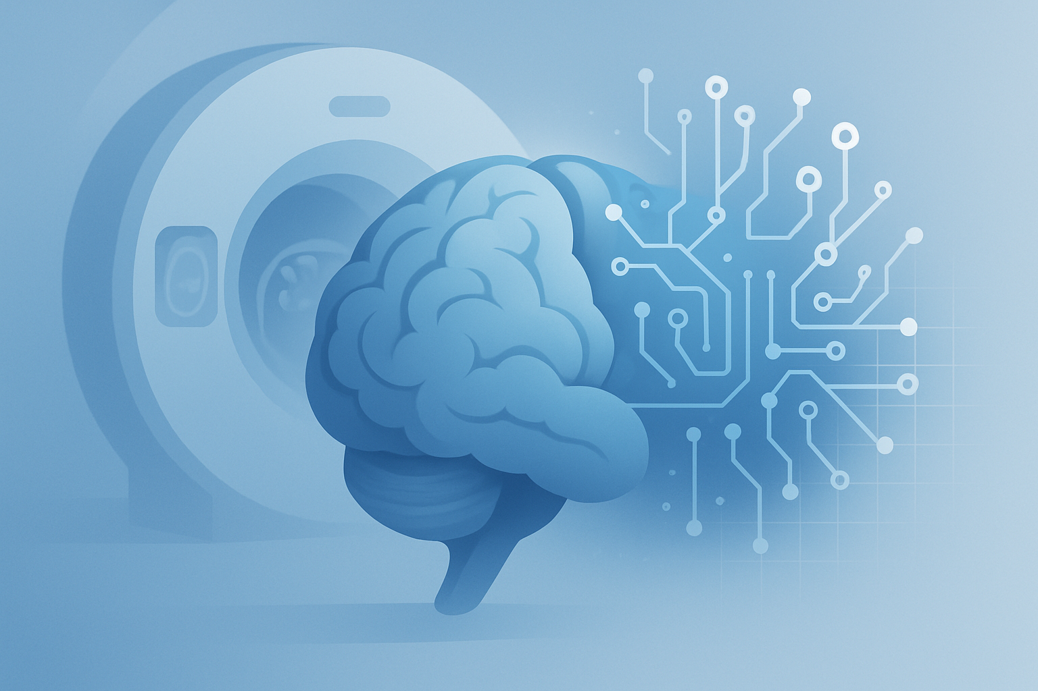


Problem Statement :
Brain tumors are dangerous and early diagnosis is critical.
Manual analysis of MRI images is time-consuming and error-prone.
Existing AI tools are often costly and not user-friendly.
Goal: Build a web-based solution for fast, accurate classification of brain tumors.
Yarmouk University – Information System Department
Brain Tumor Classification using Deep Learning
GRADUATION PROJECT – 2025

Slide 2
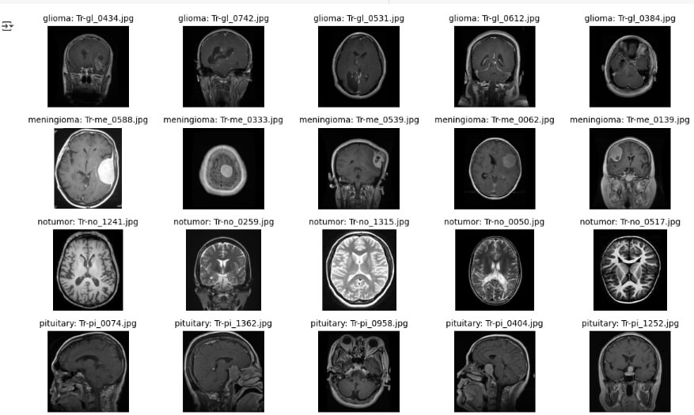
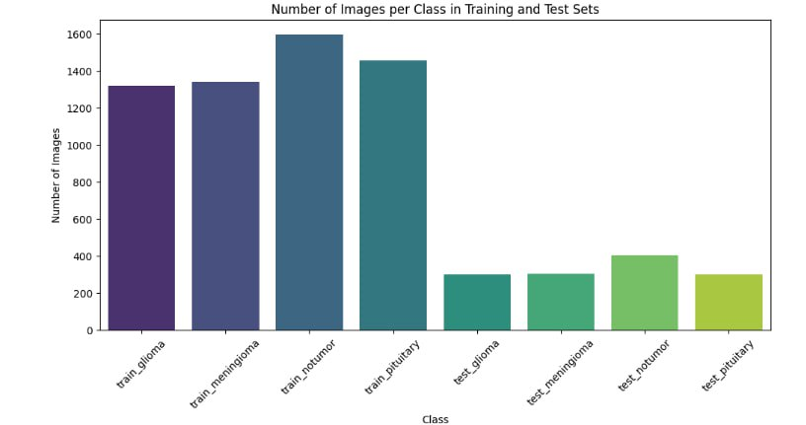
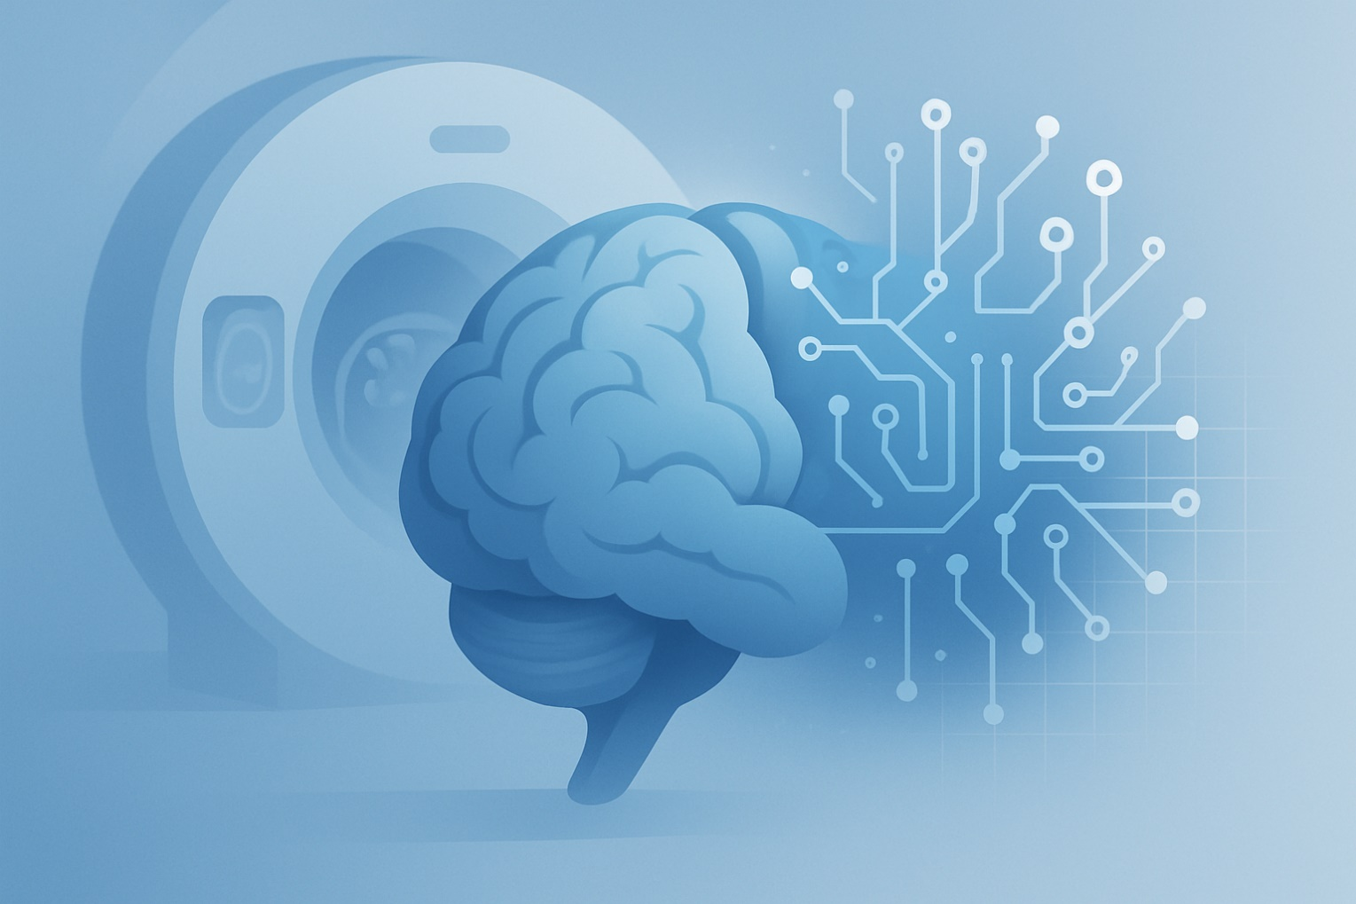
Dataset
Source: Kaggle Brain Tumor MRI Dataset
This dataset contains 7023 images
5712 Training
1311 Testing
Categories:
  Glioma
  Meningioma
  Pituitary
  No Tumor
Yarmouk University – Information System Department
Problem Statement
Brain tumors are dangerous and early diagnosis is critical.
Manual analysis of MRI images is time-consuming and error-prone.
Existing AI tools are often costly and not user-friendly.
Goal: Build a web-based solution for fast, accurate classification of brain tumors.
Brain Tumor Classification using Deep Learning
Supervisor
Dr. Ali Malkawi
Team Members
Saba Lamea
Banan Obiedat
Nadia Khair
Saja Zreqat
GRADUATION PROJECT – 2025

Slide 3
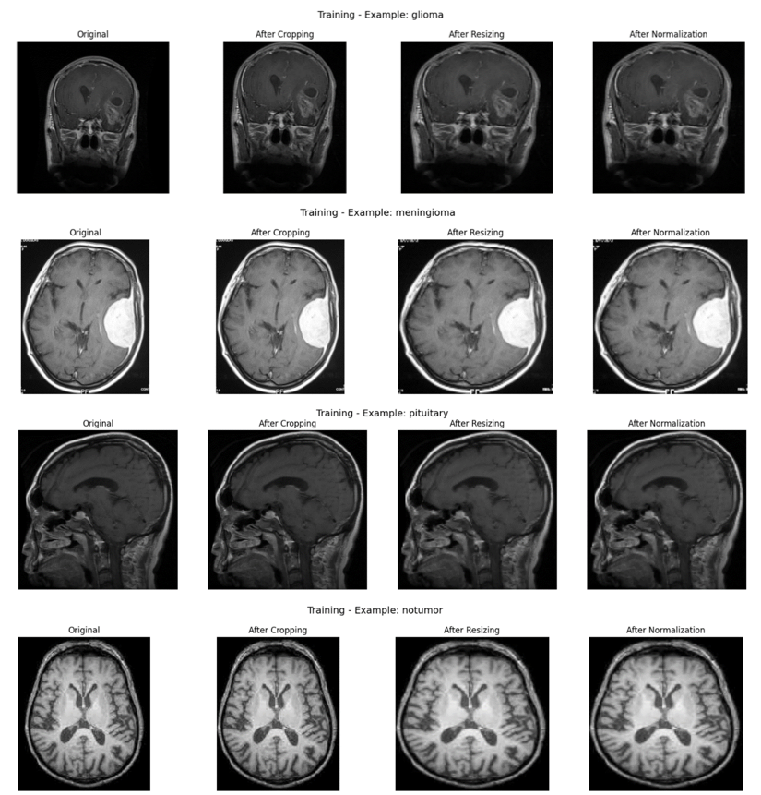
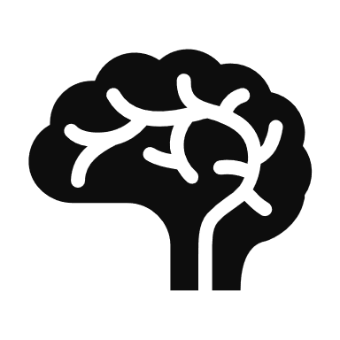
Preprocessing:
  Cropping
  Resize to 124x124
  normalization
  Data augmentation to prevent overfitting
Yarmouk University – Information System Department
Cropping
  Resize to 124x124
Dataset
  Data augmentation to prevent overfitting
Source:
Kaggle Brain Tumor MRI Dataset
This dataset contains 7023 images
5712 Training
1311 Testing
Categories:
Glioma
Meningioma
Pituitary
No Tumor
Source: Kaggle Brain Tumor MRI Dataset
This dataset contains 7023 images
5712 Training
1311 Testing
Categories:
  Glioma
  Meningioma
  Pituitary
  No Tumor
Brain Tumor Classification using Deep Learning
  normalization
Dataset
Supervisor
Dr. Ali Malkawi
Team Members
Saba Lamea
Banan Obiedat
Nadia Khair
Saja Zreqat
GRADUATION PROJECT – 2025

Slide 4
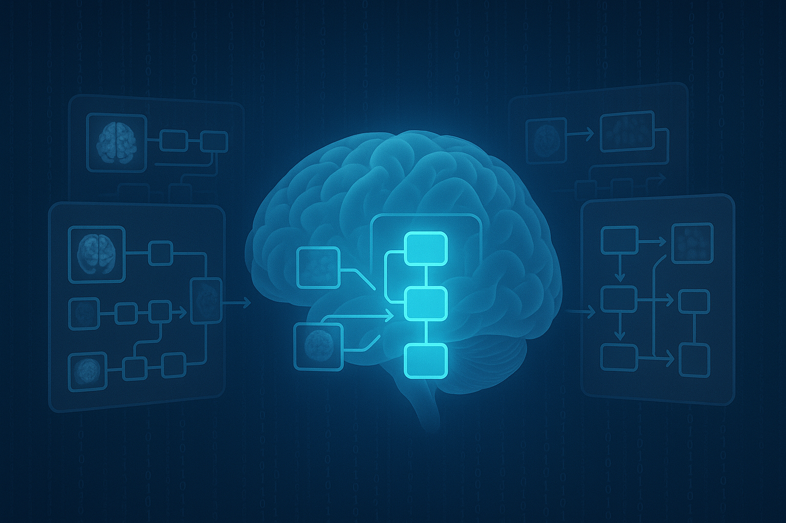
Models Used :
Custom CNN
Pre-trainded Models:
  ResNet50
  VGG16
  MobileNetV2
  DenseNet121
(with Transfer Learning)
Best performance from VGG16 (Accuracy: 97%)
  Cropping
  Resize to 124x124
  normalization
  Data augmentation to prevent overfitting
Preprocessing:
Yarmouk University – Information System Department
Preprocessing:
Cropping
  normalization
Source: Kaggle Brain Tumor MRI Dataset
This dataset contains 7023 images
5712 Training
1311 Testing
Categories:
  Glioma
  Meningioma
  Pituitary
  No Tumor
Brain Tumor Classification using Deep Learning
Dataset
  Data augmentation to prevent overfitting
  Resize to 124x124
Supervisor
Dr. Ali Malkawi
Team Members
Saba Lamea
Banan Obiedat
Nadia Khair
Saja Zreqat
GRADUATION PROJECT – 2025
Source:
Kaggle Brain Tumor MRI Dataset
This dataset contains 7023 images
5712 Training
1311 Testing
Categories:
Glioma
Meningioma
Pituitary
No Tumor

Slide 5



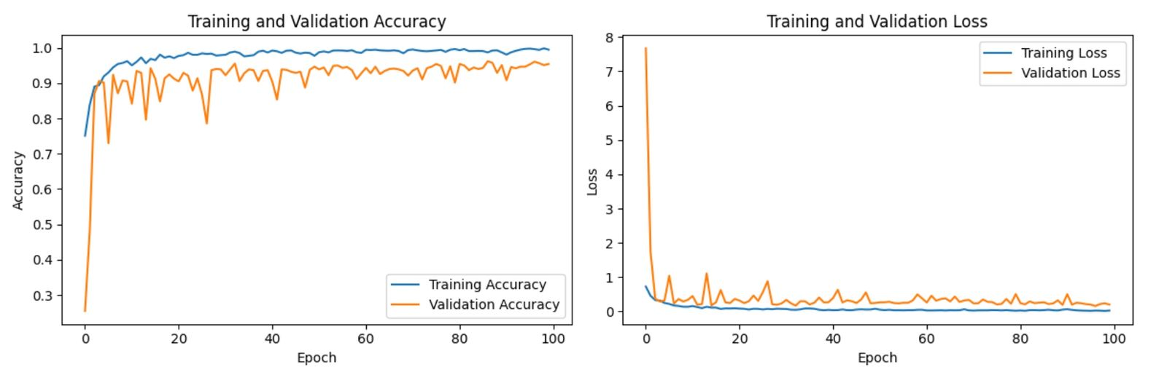
Custom CNN Model
Built from scratch using Keras
Included Conv2D, ReLU, MaxPooling, Dropout, Dense layers
Achieved 94% test accuracy
Used techniques like early stopping and data augmentation to reduce overfitting
  Cropping
  Resize to 124x124
  normalization
  Data augmentation to prevent overfitting
Preprocessing:
Yarmouk University – Information System Department
Models Used
Cropping
  normalization
  Data augmentation to prevent overfitting
Custom CNN
Pre-trainded Models:
  ResNet50
  VGG16
  MobileNetV2
  DenseNet121
(with Transfer Learning)
Best performance from VGG16 (Accuracy: 97%)
  Resize to 124x124
Source: Kaggle Brain Tumor MRI Dataset
This dataset contains 7023 images
5712 Training
1311 Testing
Categories:
  Glioma
  Meningioma
  Pituitary
  No Tumor
Brain Tumor Classification using Deep Learning
Dataset
Supervisor
Dr. Ali Malkawi
Team Members
Saba Lamea
Banan Obiedat
Nadia Khair
Saja Zreqat
GRADUATION PROJECT – 2025
Source:
Kaggle Brain Tumor MRI Dataset
This dataset contains 7023 images
5712 Training
1311 Testing
Categories:
Glioma
Meningioma
Pituitary
No Tumor

Slide 6
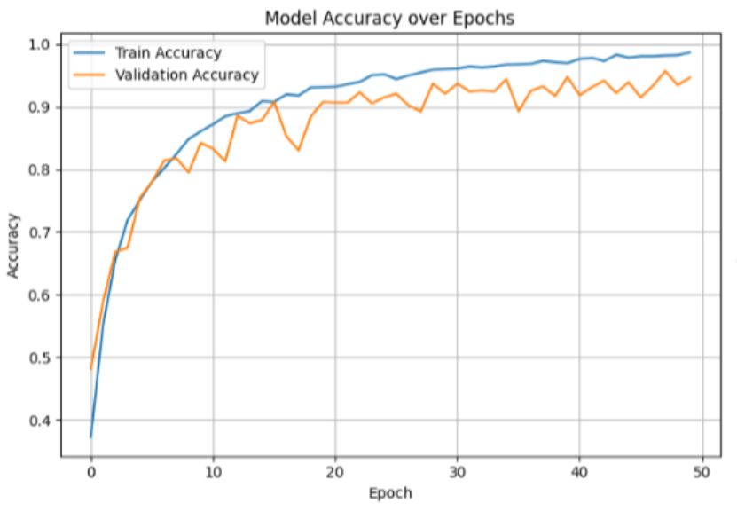
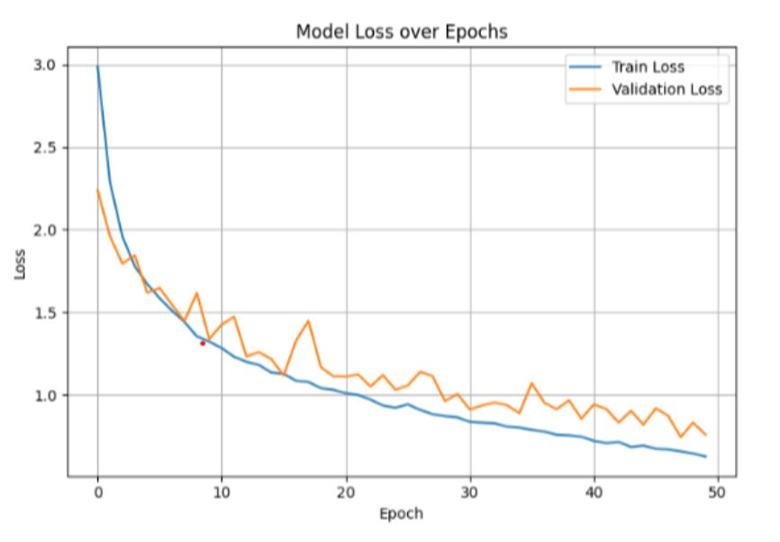
VGG16 Highlights
Used transfer learning and fine-tuning
Unfroze last 4 layers and added custom dense layers
Achieved 97.86% test accuracy
Slight overfitting handled with dropout and data augmentation
  Cropping
  Resize to 124x124
  normalization
  Data augmentation to prevent overfitting
Preprocessing:
Yarmouk University – Information System Department
Custom CNN Model
Custom CNN Model
Cropping
  normalization
Custom CNN
Pre-trainded Models:
  ResNet50
  VGG16
  MobileNetV2
  DenseNet121
(with Transfer Learning)
Best performance from VGG16 (Accuracy: 97%)
Built from scratch using Keras
Included Conv2D, ReLU, MaxPooling, Dropout, Dense layers
Achieved 94% test accuracy
Used techniques like early stopping and data augmentation to reduce overfitting
  Data augmentation to prevent overfitting
  Resize to 124x124
Source: Kaggle Brain Tumor MRI Dataset
This dataset contains 7023 images
5712 Training
1311 Testing
Categories:
  Glioma
  Meningioma
  Pituitary
  No Tumor
Brain Tumor Classification using Deep Learning
Dataset
Supervisor
Dr. Ali Malkawi
Team Members
Saba Lamea
Banan Obiedat
Nadia Khair
Saja Zreqat
GRADUATION PROJECT – 2025
Source:
Kaggle Brain Tumor MRI Dataset
This dataset contains 7023 images
5712 Training
1311 Testing
Categories:
Glioma
Meningioma
Pituitary
No Tumor

Slide 7
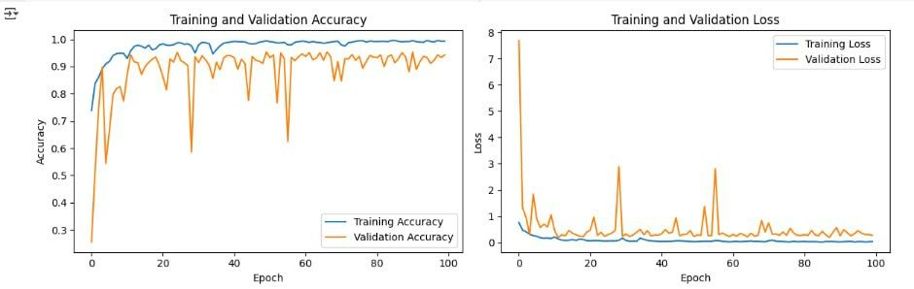
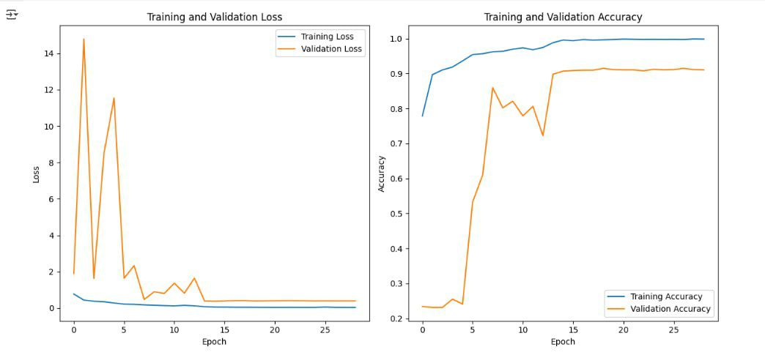
Cropping
ResNet50 Highlights
Transfer learning with pretrained ImageNet weights
GlobalAveragePooling, Dropout, L2 regularization used
Achieved 95.42% test accuracy
Strong performance with high generalization
Yarmouk University – Information System Department
VGG16 Highlights
Used transfer learning and fine-tuning
Unfroze last 4 layers and added custom dense layers
Achieved 99% Train accuracy
Achieved 98% test accuracy
Slight overfitting handled with dropout and data augmentation

Slide 8
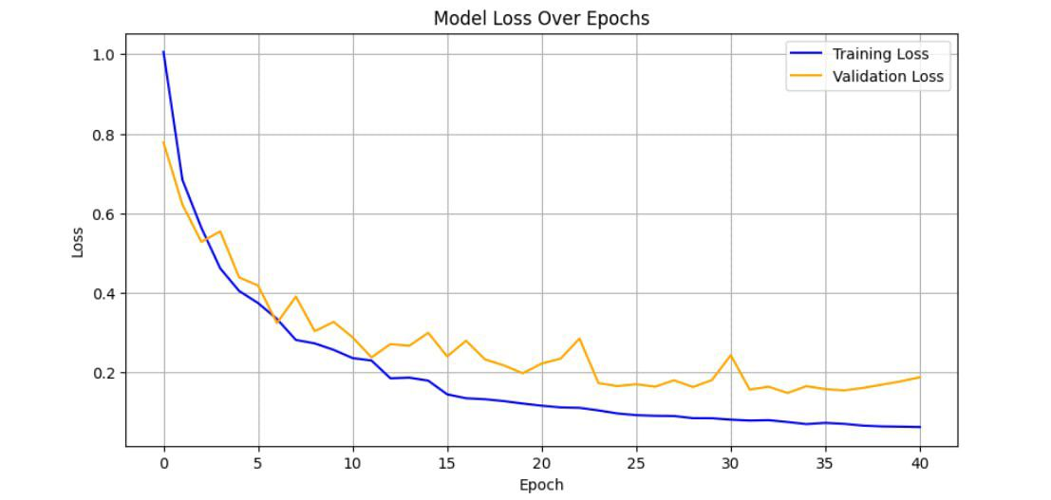
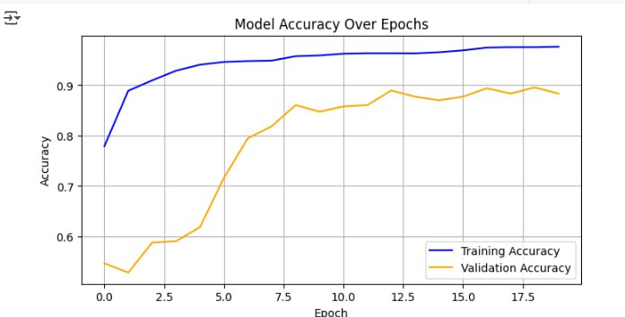
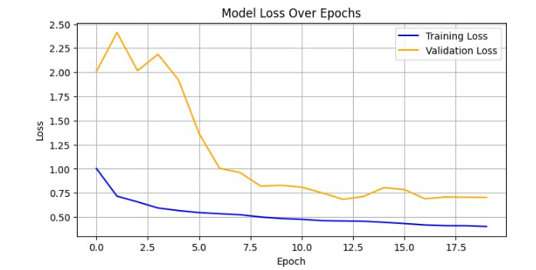
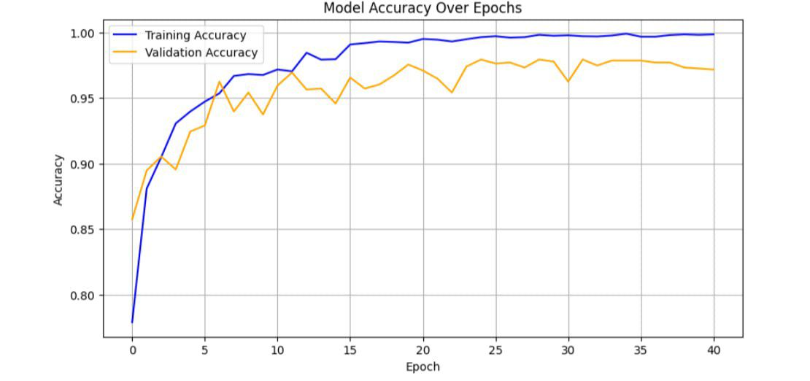
Cropping
Yarmouk University – Information System Department
MobileNet V2:
ResNet50 Highlights
Transfer learning with pretrained ImageNet weights
Inverted residual blocks, linear bottlenecks, and depthwise convolutions used
Achieved 90.62% test accuracy
Lightweight model with strong results and low overfitting risk
Transfer learning with pretrained ImageNet weights
GlobalAveragePooling, Dropout, L2 regularization used
Achieved 95.42% test accuracy
Strong performance with high generalization

Slide 9
Cropping
Model Comparison
Custom CNN: 94% accuracy
ResNet50: 95.4% accuracy
VGG16: 97.9% accuracy
Each model evaluated using precision, recall, F1-score and confusion matrix
MobileNet V2
Each model evaluated using precision, recall, F1-score and confusion matrix
Custom CNN: 94% accuracy
ResNet50: 95.4% accuracy
VGG16: 97.9% accuracy
Transfer learning with pretrained ImageNet weights
Inverted residual blocks, linear bottlenecks, and depthwise convolutions used
Achieved 90.62% test accuracy
Lightweight model with strong results and low overfitting risk

Slide 10
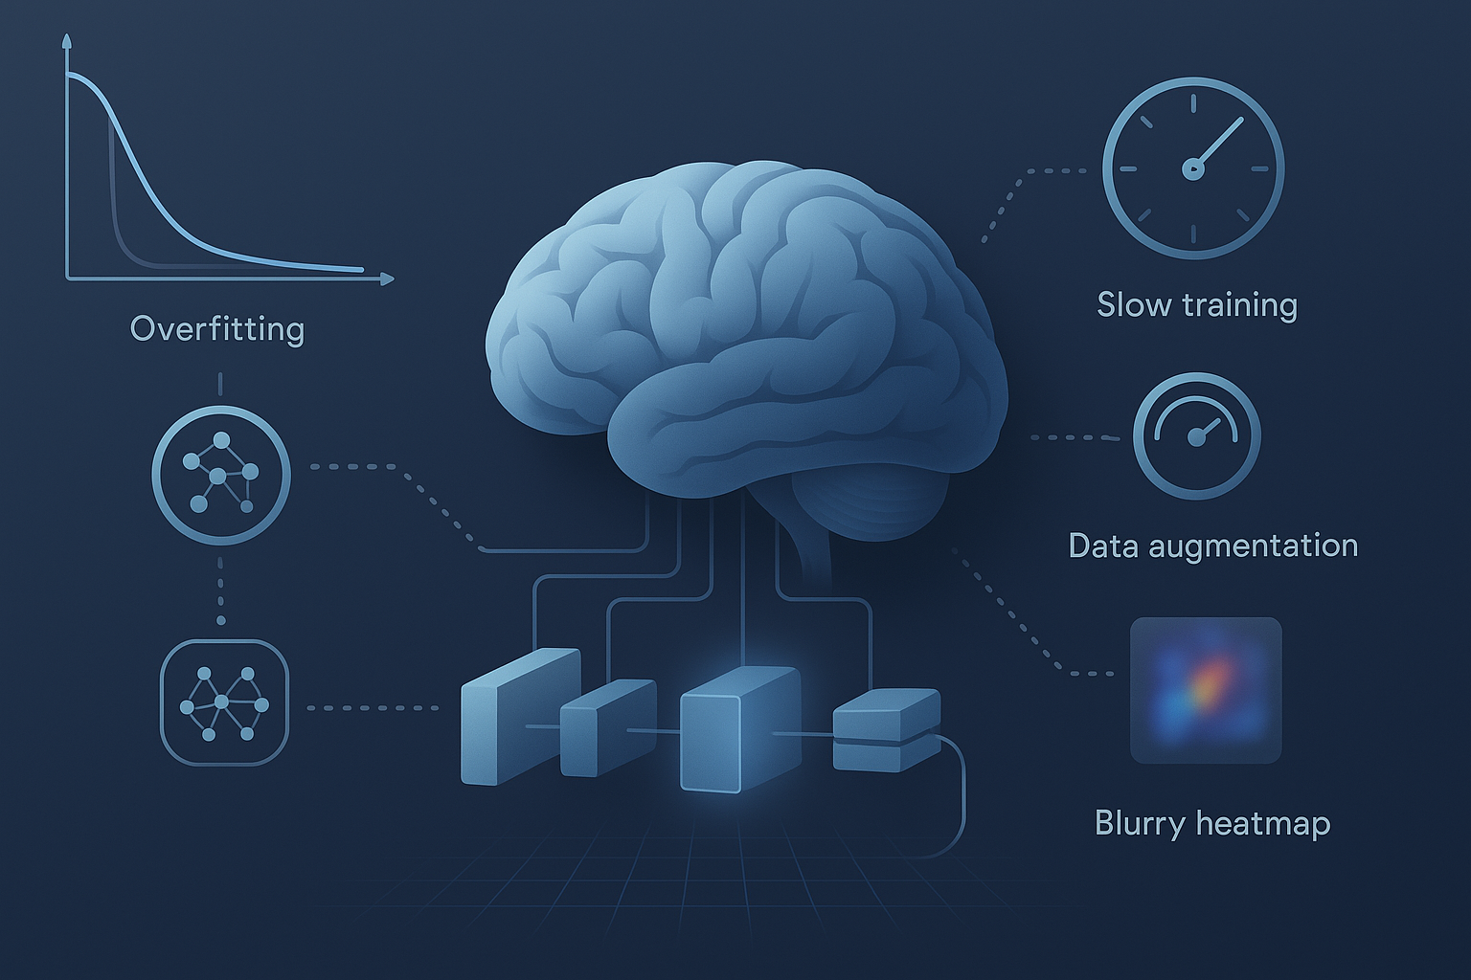
Cropping
Challenges & Solutions :
Overfitting: Solved with dropout & data augmentation
Training Time: Solved using image resizing & early stopping
Limited Data: Handled with augmentation and transfer learning
Explainability: Plan to add Grad-CAM for visual insights
Model Comparison
Each model evaluated using precision, recall, F1-score and confusion matrix
Custom CNN: 94% accuracy
ResNet50: 95.4% accuracy
VGG16: 97.9% accuracy
Transfer learning with pretrained ImageNet weights
Inverted residual blocks, linear bottlenecks, and depthwise convolutions used
Achieved 90.62% test accuracy
Lightweight model with strong results and low overfitting risk

Slide 11
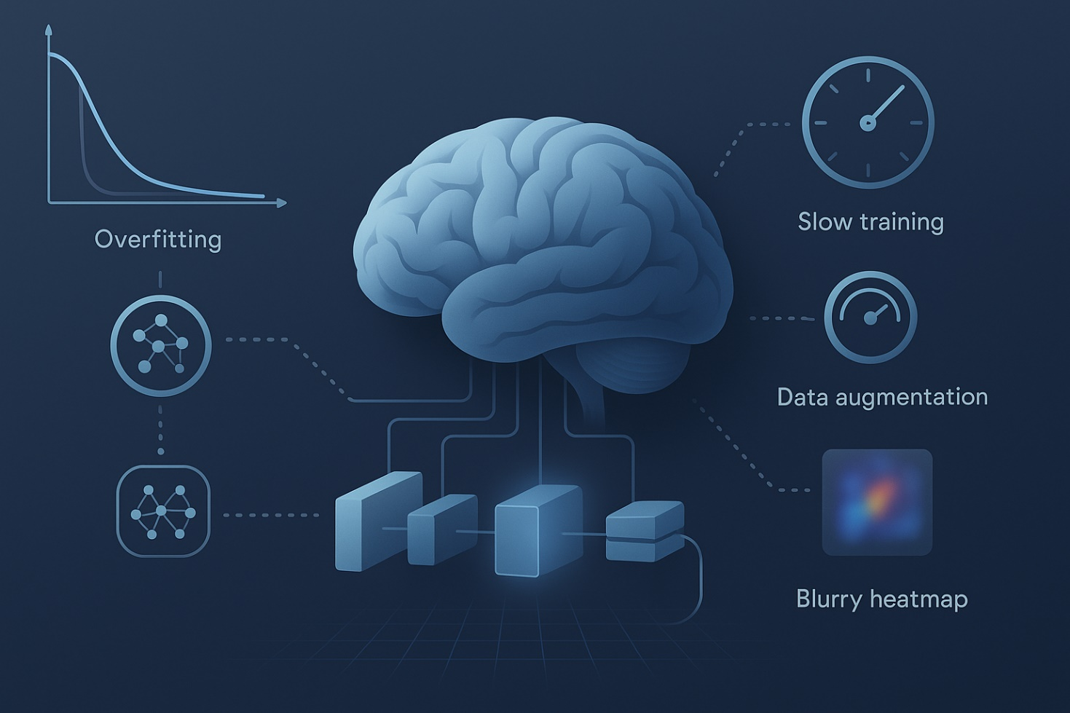
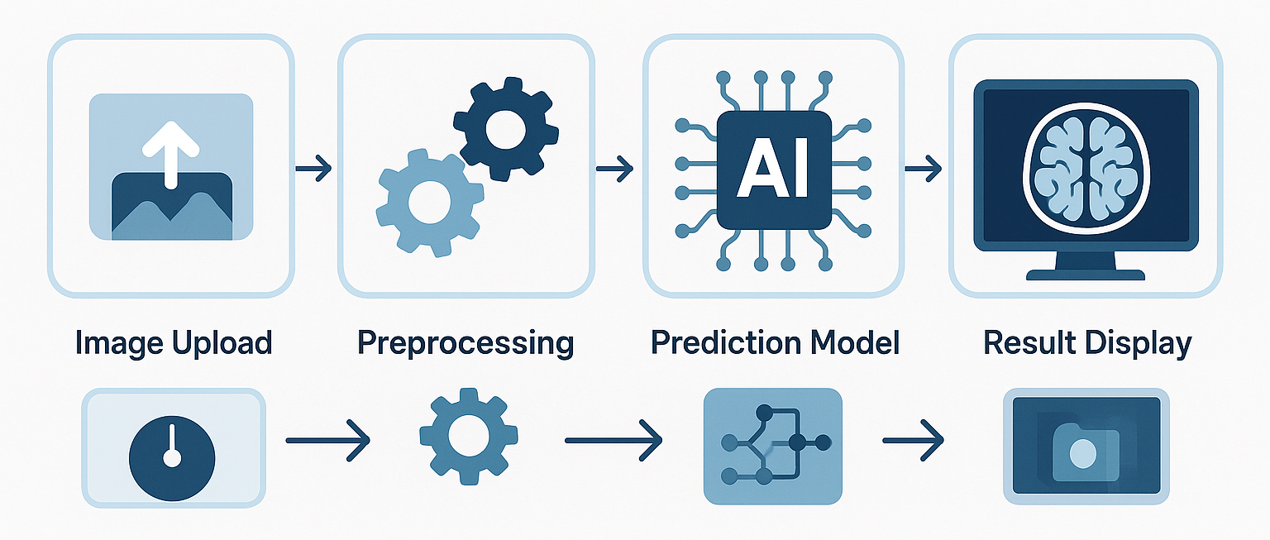
Cropping
System Overview :
Architecture:
  Image Upload
  Preprocessing
  Prediction (CNN / ResNet50 / VGG16 / MobileNet V2)
  Display Result
  Image Upload → Preprocessing → Prediction Model → Result Display
Built using: Flask, HTML/CSS, Python, TensorFlow/Keras
Deployed on a website accessible on all devices
Challenges & Solutions
ResNet50: 95.4% accuracy
VGG16: 97.9% accuracy
Each model evaluated using precision, recall, F1-score and confusion matrix
Overfitting: Solved with dropout & data augmentation
Training Time: Solved using image resizing & early stopping
Limited Data: Handled with augmentation and transfer learning
Explainability: Plan to add Grad-CAM for visual insights
Transfer learning with pretrained ImageNet weights
Inverted residual blocks, linear bottlenecks, and depthwise convolutions used
Achieved 90.62% test accuracy
Lightweight model with strong results and low overfitting risk

Slide 12
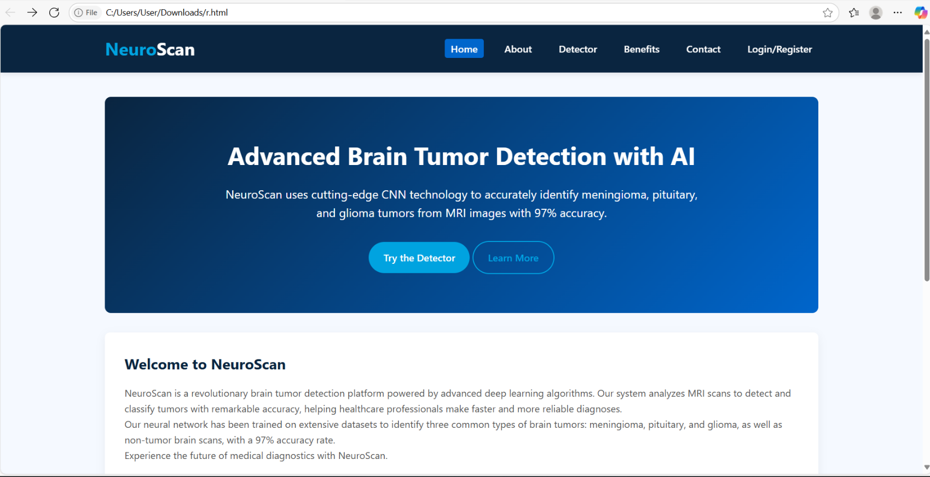
Cropping
Web Application Demo :
Easy to use UI
Real-time result display
Mobile and desktop compatibility
Simple upload form and instant result display
Supports doctors, students, researchers
System Overview
Architecture
ResNet50: 95.4% accuracy
VGG16: 97.9% accuracy
Each model evaluated using precision, recall, F1-score and confusion matrix
Transfer learning with pretrained ImageNet weights
Inverted residual blocks, linear bottlenecks, and depthwise convolutions used
Achieved 90.62% test accuracy
Lightweight model with strong results and low overfitting risk
Built using: Flask, HTML/CSS, Python, TensorFlow/Keras
Deployed on a website accessible on all devices

Slide 13

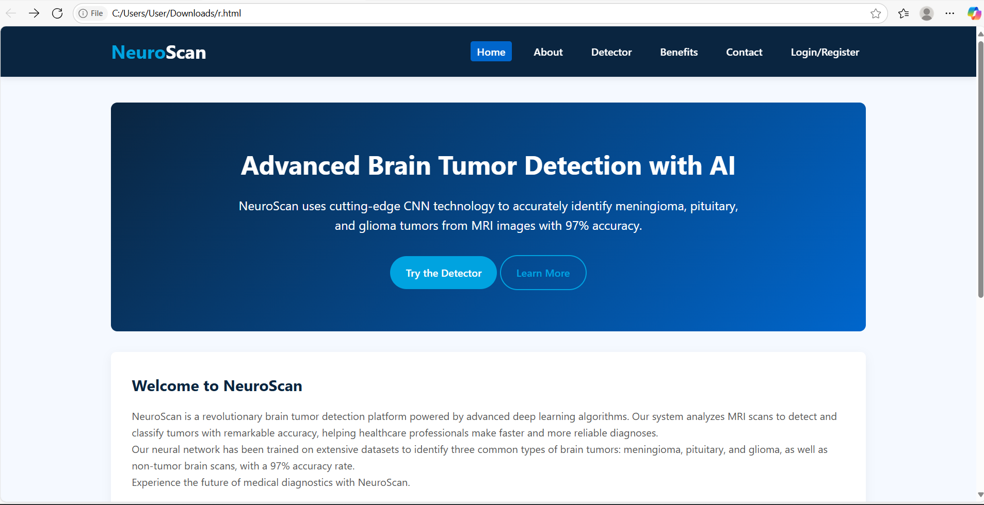
Cropping
Future Enhancements :
Support for DICOM medical image format
Mobile App version
Multi-language support
Integration with hospital systems
Add explainability tools for doctors
Train on more diverse datasets for better generalization
Web Application Demo
Easy to use UI
Real-time result display
Mobile and desktop compatibility
Simple upload form and instant result display
Supports doctors, students, researchers
ResNet50: 95.4% accuracy
VGG16: 97.9% accuracy
Each model evaluated using precision, recall, F1-score and confusion matrix
Transfer learning with pretrained ImageNet weights
Inverted residual blocks, linear bottlenecks, and depthwise convolutions used
Achieved 90.62% test accuracy
Lightweight model with strong results and low overfitting risk

Slide 14

Future Enhancements
THANK YOUfor your attention !
Support for DICOM medical image format
Mobile App version
Multi-language support
Integration with hospital systems
Add explainability tools for doctors
Train on more diverse datasets for better generalization
ResNet50: 95.4% accuracy
Presented By:
VGG16: 97.9% accuracy
Each model evaluated using precision, recall, F1-score and confusion matrix
Cropping
Saba Lamea
Saja Zreqat
Nadia Khair
Banan Obiedat
Transfer learning with pretrained ImageNet weights
Inverted residual blocks, linear bottlenecks, and depthwise convolutions used
Achieved 90.62% test accuracy
Lightweight model with strong results and low overfitting risk
Supervisor: Dr. Ali Malkawi

Slide 15
Thank You For Your Attention !
Presented By:
ResNet50: 95.4% accuracy
VGG16: 97.9% accuracy
Each model evaluated using precision, recall, F1-score and confusion matrix
Cropping
Saba Lamea
Saja Zreqat
Nadia Khair
Banan Obiedat
Transfer learning with pretrained ImageNet weights
Inverted residual blocks, linear bottlenecks, and depthwise convolutions used
Achieved 90.62% test accuracy
Lightweight model with strong results and low overfitting risk
Supervisor: Dr. Ali Malkawi

